Slide 1
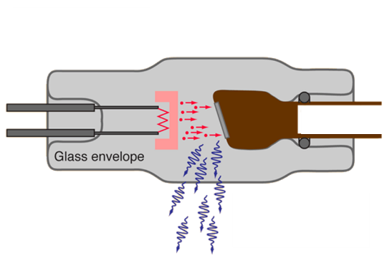
X-ray System Function
Radiology fundamentals
X-ray tube
Production of x-rays
Nature and properties of x-rays
X-ray detection
Photographically correct x-ray images
Contrast
Sharpness
18.6.1 Explain how an x-ray machine generates and detects images
Unit C18.6 Maintaining Medical Imaging Equipment
Module 279 19 C Medical Instrumentation II
©
dr. Chris R. Mol, BME, NORTEC, 2016

Slide 2
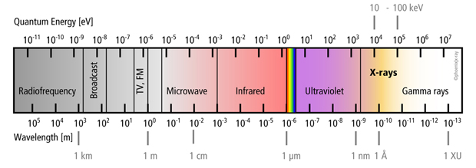
Nature and properties of x-rays
X-rays are electromagnetic waves/quanta with more energy (and a shorter wavelength) than light. For this reason X-rays can penetrate into the (human) body and still get partly absorbed, making it a great wavelength for making images of the body.
Neighbouring Ultraviolet radiation does not go through the body, while Gamma rays go right through it with little absorption.
Electro-Magnetic radiation Spectrum
Medical X-ray uses X-rays with an energy of between 40 and 120 keV. The higher energies are used when more penetration is needed, i.e. in thicker objects. An X-ray filter (often made of Copper or Aluminum) is used to filter out the lower, non-productive X-ray energies.
X-rays are absorbed more by ‘dense’ materials, such as metals and bone; it will be little absorbed by gas (lungs). ‘Soft tissue’ absorption will be somewhat in the middle of this.
©
Radiology Fundamentals
dr. Chris R. Mol, BME, NORTEC, 2016

Slide 3
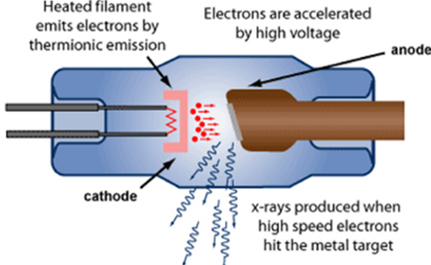
Production of x-rays
X-rays are produced by ‘shooting’ high energy electrons on a piece of metal (tungsten or molybdenum), called the ‘anode’. The electrons are absorbed in this metal and cause the creation of X-ray radiation.
You get high energy electrons by taking low energy electrons and accelerating these by means of a high electric voltage. This high voltage is created by the X-ray generator and applied between the anode (+), attracting the electrons, and the cathode (-).
Low energy electrons are created by creating an electric current through a special thin wire (tungsten filament). The purpose of the filament is to ‘boil off electrons’. This is similar to the generation of light by a light bulb when photons are sent out by its heated filament.
All this is accomplished in an X-ray tube.
99% of the energy released is given off as heat and only 1% is in the form of X-ray radiation! Getting rid of the heat is a major issue in tube design and operation.
©
Radiology Fundamentals
dr. Chris R. Mol, BME, NORTEC, 2016

Slide 4
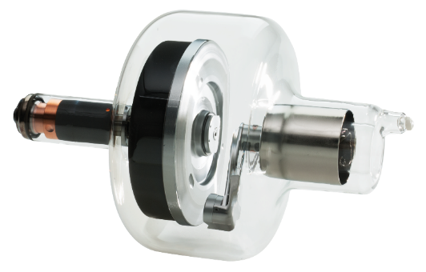
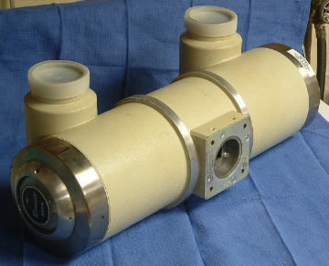
X-ray tube
X-ray tubes wear out and need to be replaced regularly. Depending on use this will be done every 2-4 years or longer.
High Voltage In
Anode disc rotation mechanism (‘rotor’)
X-ray Out
anode disk
kathode
X-ray Tube Container
protects the tube from mechanical shock and absorbs stray X-ray radiation
X-ray Tube ‘Insert’; the inside is vacuum
©
Radiology Fundamentals
dr. Chris R. Mol, BME, NORTEC, 2016

Slide 5
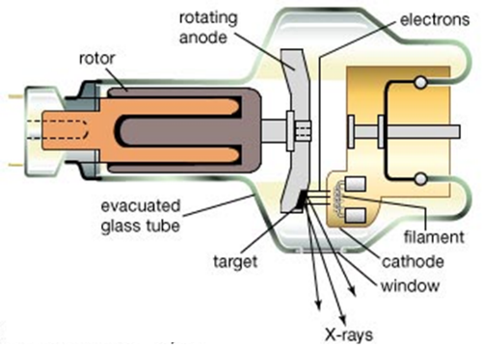
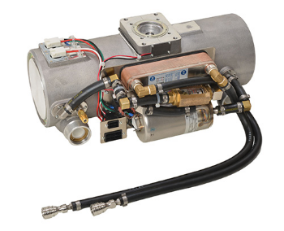
X-ray tube
In high end X-ray tubes, the anode is rotating, so that it can absorb more heat. Temperatures of 3000ºC can be reached.
Also, the anode may be cooled with water or with oil, that is circulated through the tube and cooled with a ‘heat exchanger’ outside the tube.
The place on the anode where X-rays are generated is called the ‘focal spot’.
tubes with cooling fluid
©
Radiology Fundamentals
dr. Chris R. Mol, BME, NORTEC, 2016

Slide 6
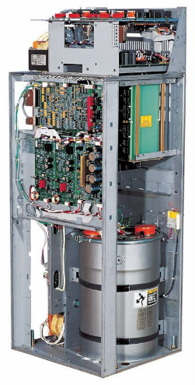
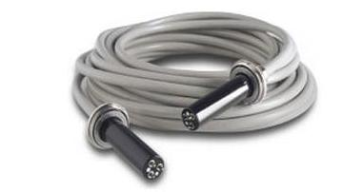
X-ray High Voltage (HV) generator
The X-ray HV generator creates the high voltage required to accelerate the electrons travelling to the anode. The high voltage used is in the order of 80 kV = 80,000 Volts.
The X-ray HV generator also creates the (low voltage) electric current that is used to heat up the filament of the X-ray tube.
A special High Voltage cable is used to connect the X-ray generator and the X-ray tube.
X-ray HV Generator
©
Radiology Fundamentals
dr. Chris R. Mol, BME, NORTEC, 2016

Slide 7
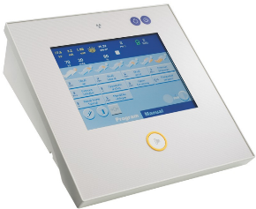
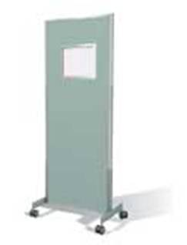
X-ray Control Unit
In simple X-ray systems, the voltage, filament current and X-ray pulse width are entered manually on a ‘generator desk’. Together, these parameters determine for a large part the resulting Image Quality.
In more modern and complex system, X-ray exposure control is performed automatically by the X-ray system. This is one reason that X-ray systems require that the user inputs what body part is being imaged. It uses this information to set the X-ray system parameters (settings).
X-ray system
user interface
(or ‘generator desk’)
Often, the control unit is located outside the X-ray room. If it is located inside the room, a radio-opaque (X-ray absorbing) protection screen, large enough to protect a standing operator, is part of the control unit. There is a lead glass window, so that the patient can be watched during the examination.
There must also be leaded protective aprons and gloves.
©
Radiology Fundamentals
dr. Chris R. Mol, BME, NORTEC, 2016

Slide 8
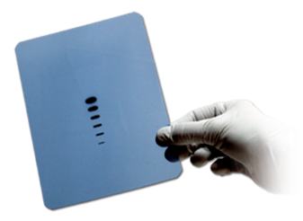
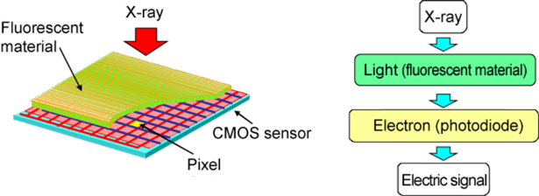
X-ray detection
‘Photographic’ film is insensitive to X-ray: 98% of X-rays would travel through without interaction.
That’s why an ‘intensifying screen’, made of fluorescent material, is mounted in front of the film. It converts the X-ray photons into visible light photons. The amount of light that it produces is proportional to the amount of incoming X-rays. The light photons are recorded by the photographic film.
The same approach is used for Image Intensifiers and Flat Detectors: X-ray is transformed into Light before it is detected / recorded.
©
Radiology Fundamentals
dr. Chris R. Mol, BME, NORTEC, 2016

Slide 9
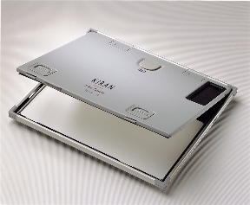
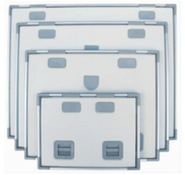
X-ray detection: cassettes and films
Cassettes are light-proof, rigid containers that enclose the X-ray film to protect it from light. Within the cassette are two intensifying screens that fluoresce and produce visible light when irradiated by X-rays. The film is placed between the two intensifying screens, inside the cassette. The cassettes must be strong, rigid and durable. They must provide firm pressure so that there is good contact between the film and the screens, but must be easy to open in the dark.
Cassettes come in different sizes
©
Radiology Fundamentals
dr. Chris R. Mol, BME, NORTEC, 2016

Slide 10
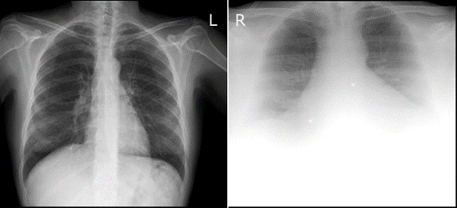
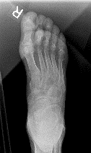
X-ray Image Quality
Most user complaints on a functioning X-ray systems are about reduced Image Quality. The factors that determine image quality are:
spatial resolution or sharpness
image contrast
image noise
image artefacts
Each of these factors can lead to reduced visibility of image details and to a sub-optimal/wrong diagnosis.
Chest X-ray of normal (left) and obese (right) patient
Image artefact caused by wrong positioning of collimator in the top left of the image
Some image quality reduction occurs in case of high X-ray absorption, as sometimes caused by obese patients.
This can lead to low contrast and high noise in the image. It can sometimes not be improved by improving the system.
©
Radiology Fundamentals
dr. Chris R. Mol, BME, NORTEC, 2016

Slide 11
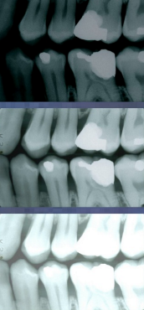
X-ray Image Quality
Exposure factors too high (too dark)
There is a long list of system factors that can cause reduced image quality. This includes:
wrong setting of exposure parameters (wrong program selected)
inexpert use of collimator, grid
wrong film selection (wrong sensitivity)
faulty chemical development bath (temperature, concentration, time)
worn-out X-ray tube
problems with Image Intensifiers (worn out, artefacts,…)
etc.
Exposure factors correct
Exposure factors too low (too light)
Dental X-ray images taken with different X-ray parameter (kV, mA, s) settings
With a Image Quality Control program the image quality is checked and optimized regularly.
Some problems can be solved by a local technician, some require expert service support.
©
Radiology Fundamentals
dr. Chris R. Mol, BME, NORTEC, 2016

Slide 12
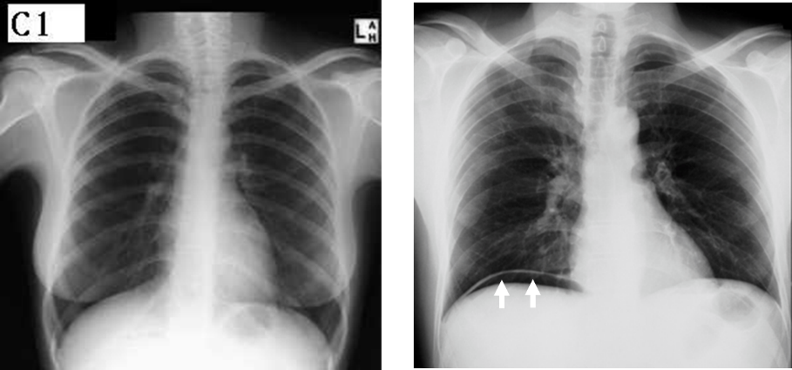
Image Contrast
Good contrast can show structures which are otherwise invisible
©
Radiology Fundamentals
dr. Chris R. Mol, BME, NORTEC, 2016

Slide 13
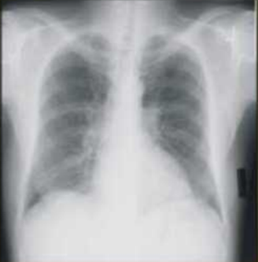
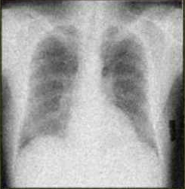
Image Noise
X-ray images are often noisy when a (too) low X-ray dose has arrived at the detector.
This is comparable to making pictures with your smartphone in the evening darkness..
low noise (left) and high noise (right) chest X-ray images
©
Radiology Fundamentals
dr. Chris R. Mol, BME, NORTEC, 2016

Slide 14
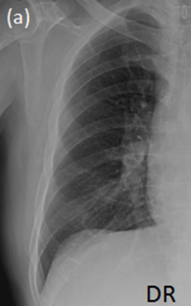
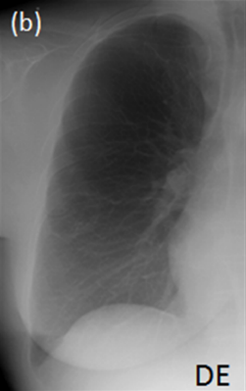
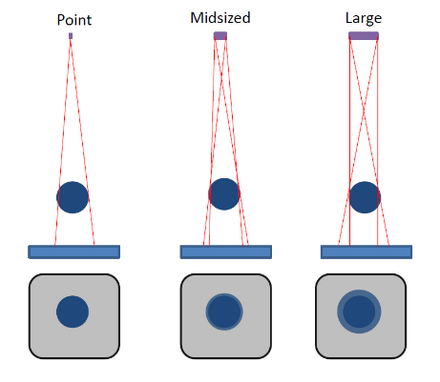
Sharpness
Sharpness/blurriness
depends on the size of the focal spot….
Chest X-ray image with high (left) and low (right) sharpness
©
Radiology Fundamentals
dr. Chris R. Mol, BME, NORTEC, 2016

Slide 15
END
The creation of this presentation was supported by a grant from THET:
see https://www.thet.org/

